Slide 1





Movie Review Sentiment Classification
By Choy Jee Hung Caleb p2341475

Slide 2


TABLE OF CONTENT
1
2
3
Data Exploration
Data Preprocessing
Model building
4
5
6
Model Improvements
Cluster
Evaluation
Results & Conclusion

Slide 3
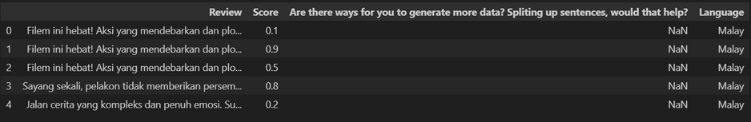
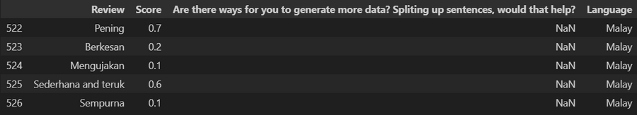
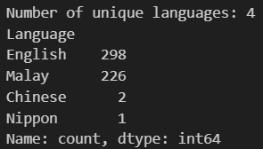
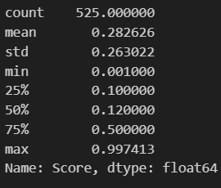
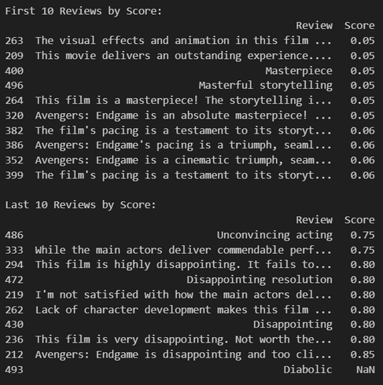
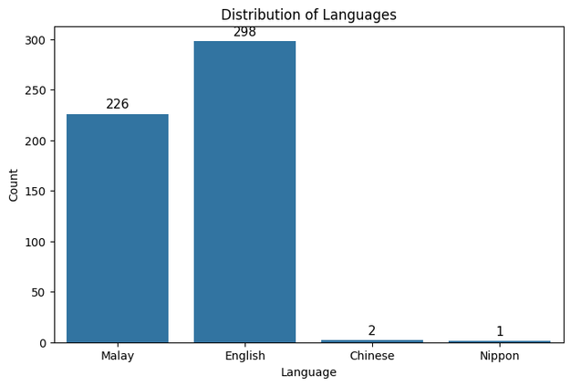
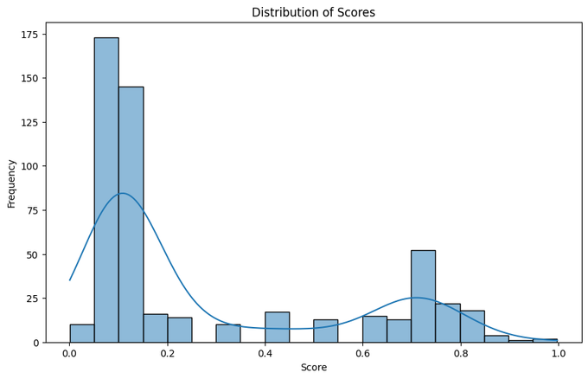

Data Exploration
Basic:
Language:
Scores:

Slide 4
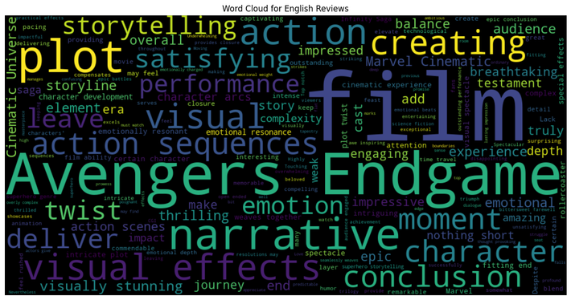

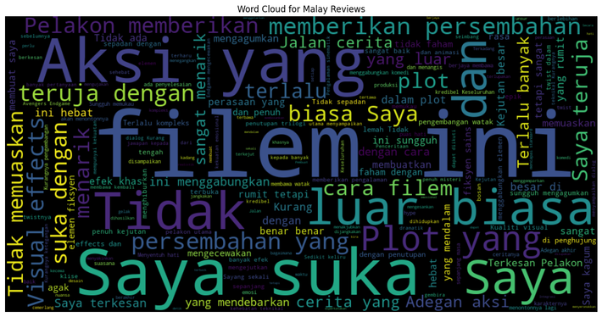
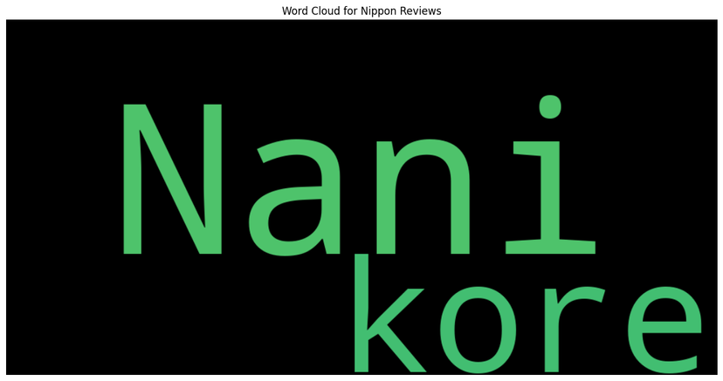



Data Exploration
Words/Sentences:

Slide 5
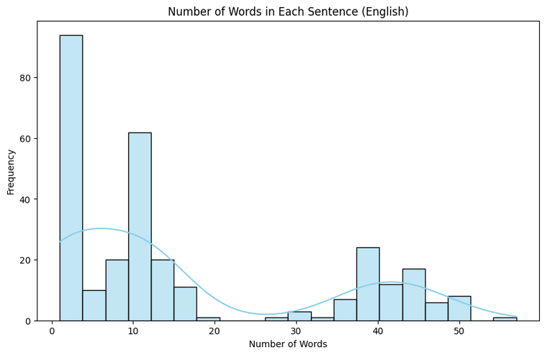
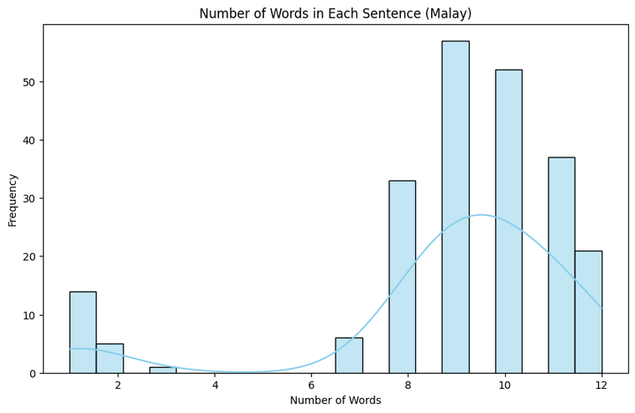
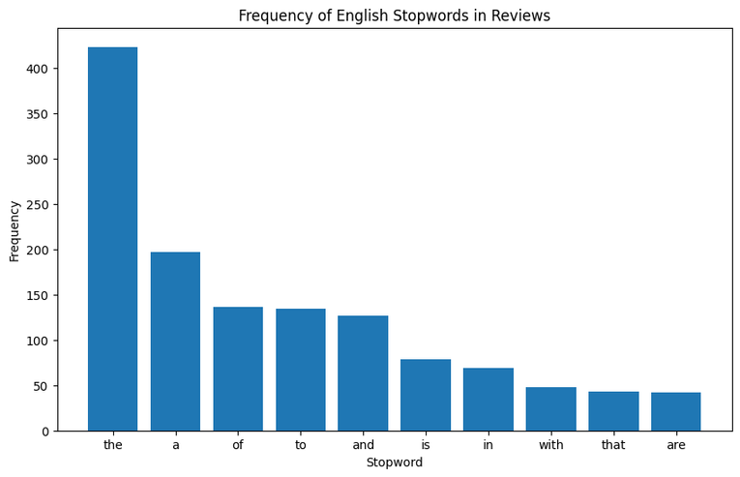
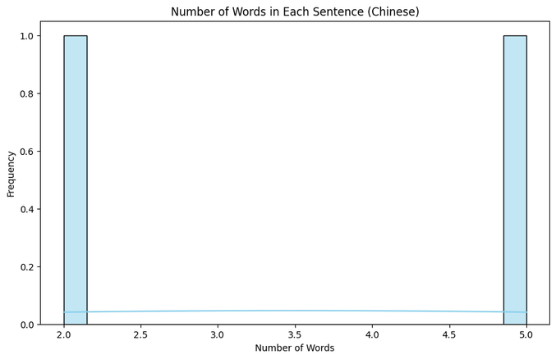
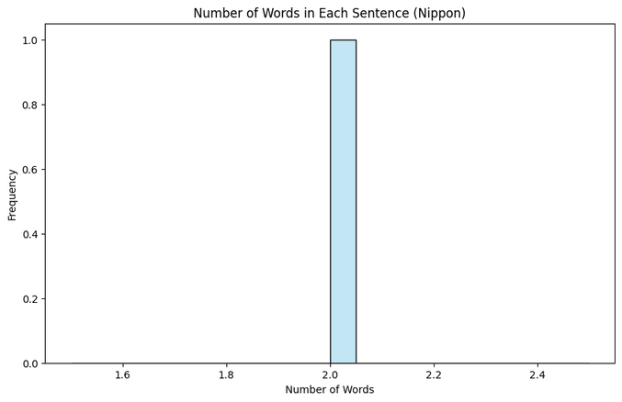
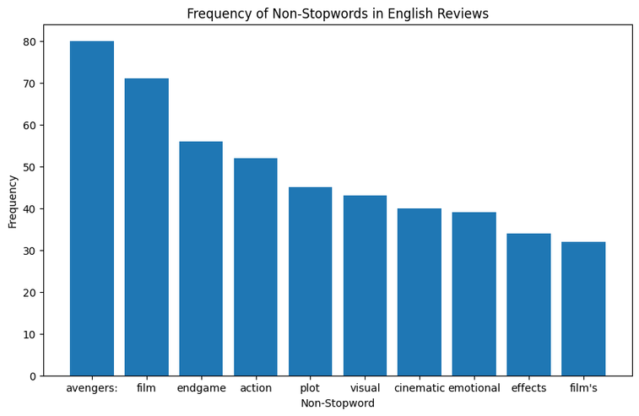
Data Exploration
Words/Sentences:

Slide 6
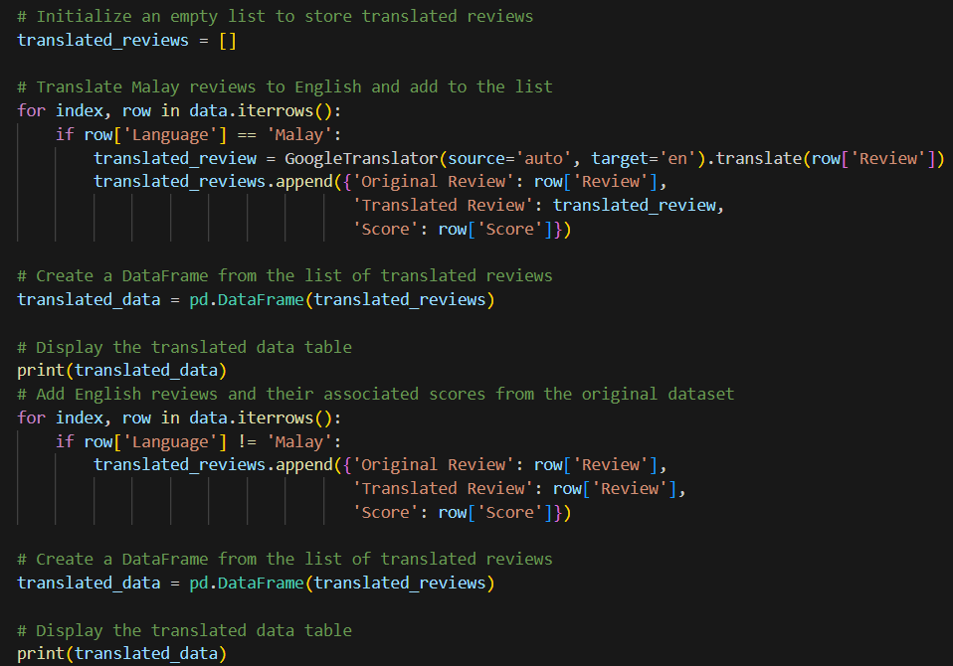
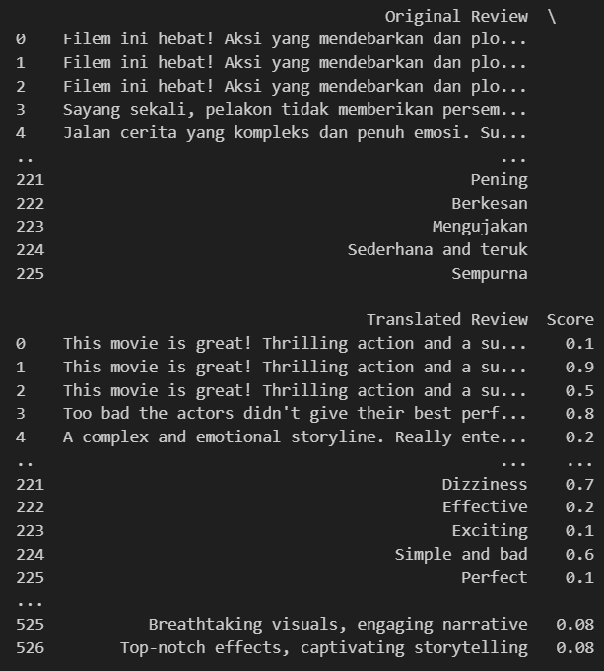
Feature Engineering - Adding New data

Slide 7
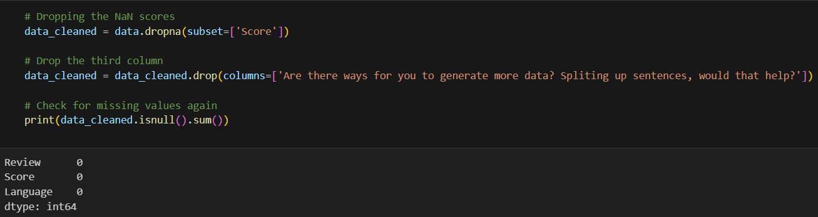
Preprocessing - Removing NaN

Slide 8
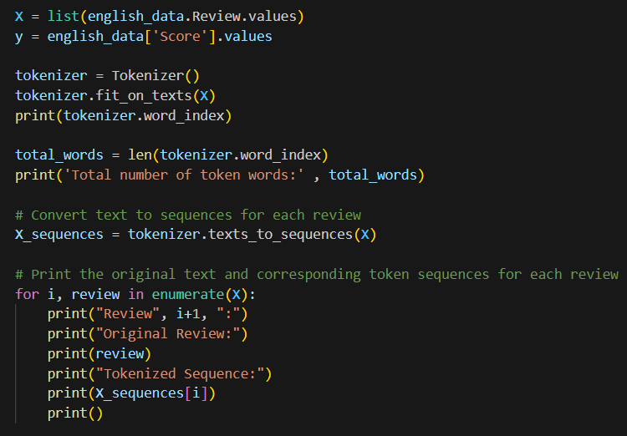
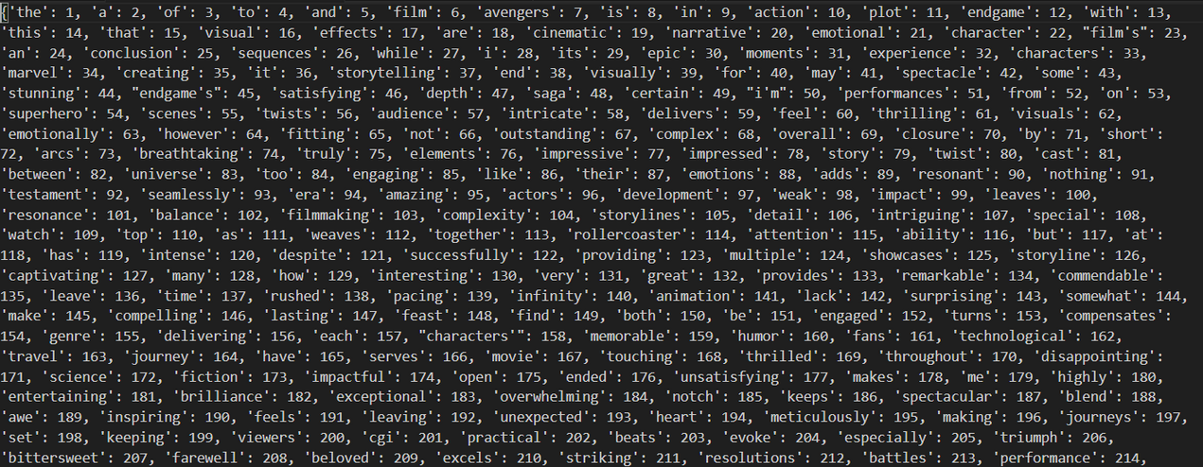
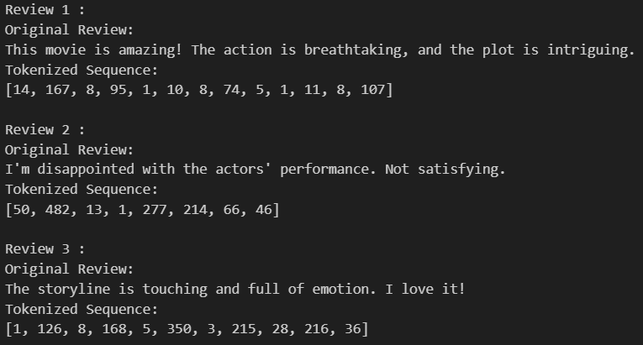
Preprocessing - Tokenizing

Slide 9
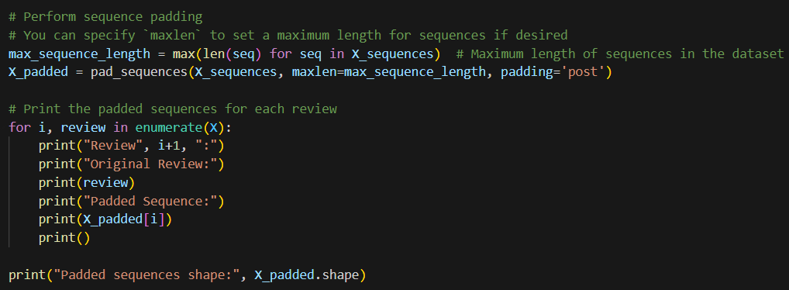
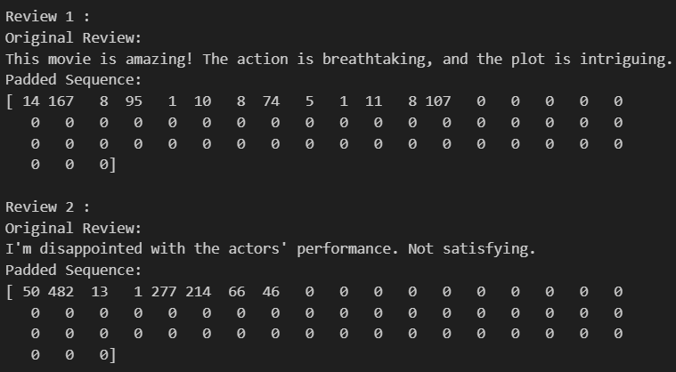
Preprocessing - Padding
Uniform Length Sequences:
- RNNs typically operate on fixed-length sequences. However, natural language processing tasks often involve variable-length sequences (e.g., sentences of varying lengths). Padding ensures that all sequences in a dataset have the same length, thus enabling efficient batch processing during training.

Slide 10



Classification vs Regression
I have chosen to do classification as the purpose would be to determine sentiment analysis makes more sense than using movie reivews to train sentence generation.
Classification
Regression
RNNs are typically used to process sequential data and make predictions about the category or class of the input sequence. For example, sentiment analysis, text classification, speech recognition, and time-series classification are common applications of RNNs in classification tasks.
For instance, knowing whether a movie review is a negative or positive review based on the words used.
In regression tasks, the goal is to predict a continuous value rather than a discrete class label. RNNs can be used for regression tasks by modifying the output layer to produce a single continuous value rather than a probability distribution. For example, predicting stock prices and time-series prediction are common regression applications of RNNs.
For instance, predicting the next word of the movie review based on the score assigned.

Slide 11
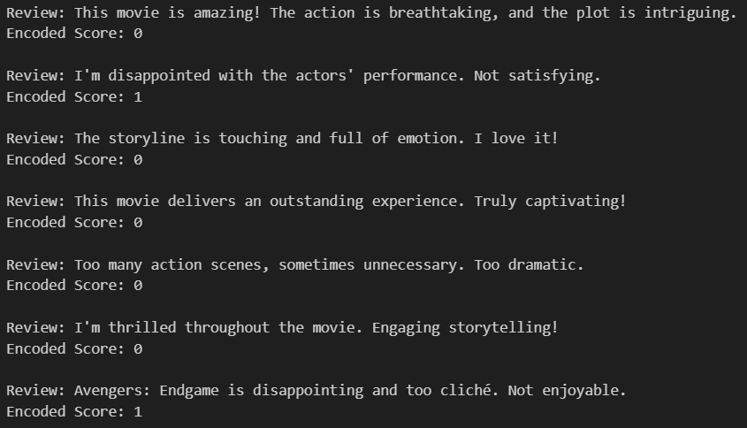
Preprocessing - Encoding
Since negative reviews have scores >0.5 and positive reviews have scores < 0.5, we can label them respectively where negative reviews are labeled with 1 while positive reviews are labeled with 0.

Slide 12
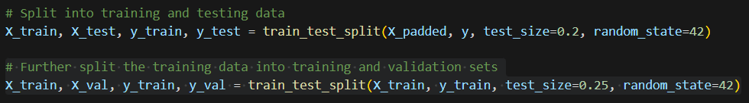
Preprocessing - Splitting the data
Model Evaluation:
By training a model on one subset (the training set) and then testing it on another subset (the test set), you can assess how well the model generalizes to unseen data. This evaluation helps you understand whether the model has learned meaningful patterns from the training data or if it is overfitting.
Preventing Overfitting:
By evaluating the model on a separate test set, you can determine whether it has overfit the training data. If the model performs well on the training set but poorly on the test set, it's a sign that it has overfit.
Hyperparameter Tuning:
Splitting the data allows you to tune hyperparameters (e.g., learning rate, regularization strength) based on the model's performance on the validation set (a subset of the training data) without introducing bias from the test set.

Slide 13

Types of RNN Models
There are four main types of footage in a documentary film.
SimpleRNN
LSTM (Long Short-Term Memory) RNN
GRU (Gated Recurrent Unit) RNN
Bi-Directional RNN
Best for short-term dependencies, simpler tasks, and lower computational requirements.
Best for capturing long-term dependencies, complex patterns, and tasks with extensive sequential data.
Balances between complexity and performance, suitable for tasks where both computational efficiency and to capture long-term dependencies are essential.
Extend the capabilities of standard RNNs by processing data in both forward and backward directions, allowing the network to have both past and future context.

Slide 14
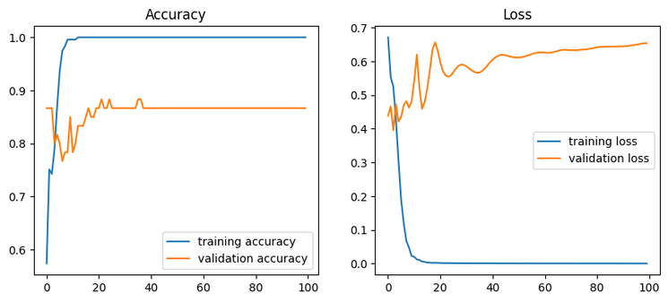
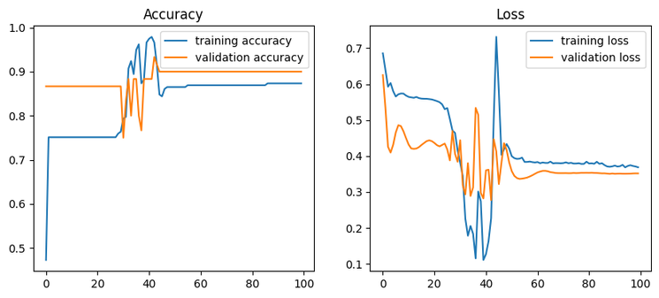
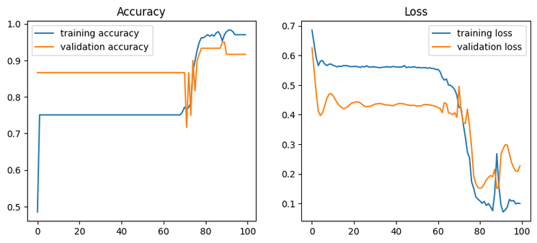



Model Building - Initial Models
SimpleRNN:
LSTM:
GRU:
SimpleRNN:
Accuracy of 86.67% and Error of 13.33%. Large overfitting is present.
LSTM:
Accuracy of 90.0% and Error of 10.0%. Overfitting is less prominent.
GRU:
Accuracy of 91.67% and Error of 8.33%. Overfitting is less prominent.

Slide 15

Bi-directional RNN
Bidirectional SimpleRNN:
Adds bidirectional context to simple RNNs, useful for basic tasks with short to medium dependencies. Still limited by the vanishing gradient problem.
Bidirectional LSTM:
Provides the most powerful context understanding by leveraging LSTM's ability to capture long-term dependencies in both directions. Best for complex and long-sequence tasks, but computationally expensive.
Bidirectional GRU:
Offers a good balance between performance and efficiency. Suitable for tasks where bidirectional context is needed, with faster training times compared to bidirectional LSTM.

Slide 16
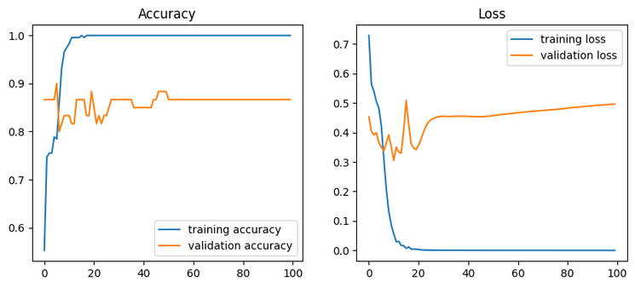
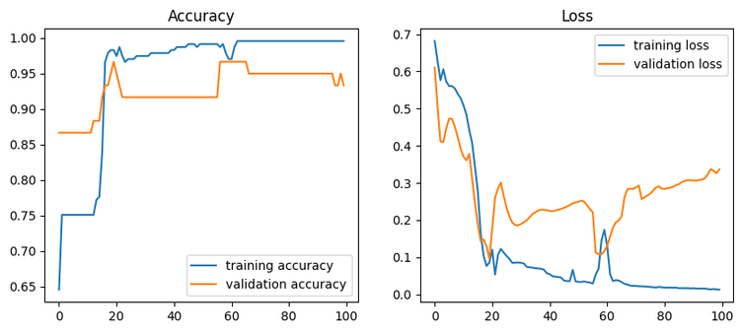
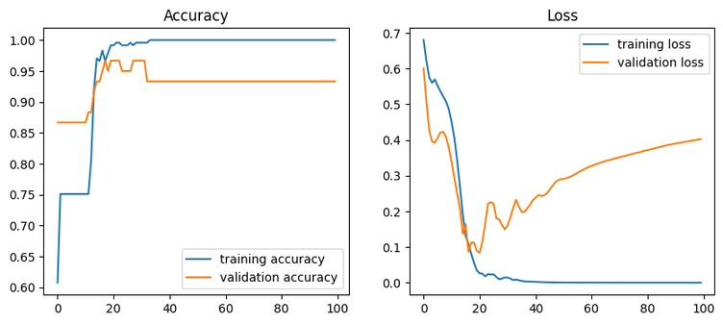



Model Building - Bidrectional Models
SimpleRNN:
LSTM:
GRU:
Bidirectional SimpleRNN:
Accuracy of 86.67% and Error of 13.33%. Large overfitting is still present.
Bidirectional LSTM:
Accuracy of 93.33% and Error of 6.67%. Overfitting has been reduced but could be better.
Bidirectional GRU:
Accuracy of 93.33% and Error of 6.67%. Overfitting became worse.

Slide 17

Chosen Model: Bidirectional LSTM
I have chosen to go with Bi-directional RNN LSTM as my model that I want to do hyperparameter tuning on to improve the model.
This is because the model has a high model accuracy of 93.33% and the stated pros and cons fit my purpose well (LSTMs can learn long-term dependencies and maintain information over long sequences, making them highly effective for text data.
Bi-Directional RNNs can capture comprehensive context, making them very effective for understanding sentiment in movie reviews.)
Since computational resources are also readily available from the lab, bidirectional LSTM is the best choice.
Overfitting is also larger in the Bi-direcitonal GRU model then the LSTM model, so we would not be using GRU.

Slide 18
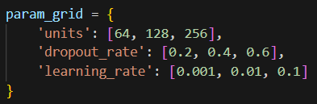
Model Improvment- BidrectionalLSTM
Parameters tuned:
units: This key corresponds to the number of units (or neurons) in a particular layer of the neural network, often the recurrent or dense layer.
dropout_rate: This key refers to the dropout rate used in the dropout layer, a regularization technique to prevent overfitting.
learning_rate: This key indicates the learning rate for the optimizer, which controls how much the model's weights are adjusted with respect to the loss gradient during training.
Search method:
Randomized Search: Randomly selects a subset of the combinations to test and find the optimal combination of hyperparameters that yield the best model performance. Can be more efficient than grid search for a quick and effective method to find good hyperparameters.

Slide 19

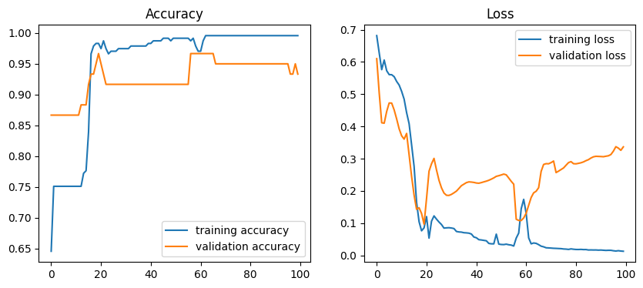
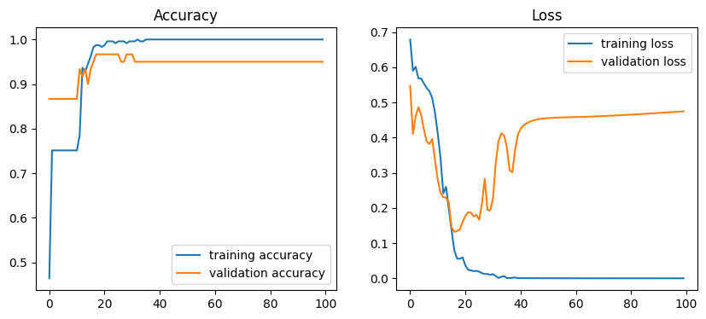


Model Evaluation - After tuning
Before:
After:
Initially, the Bi-directional LSTM model has an accuracy of 93.33% and an error rate of 6.67%
After tuning, the model accuracy increased to 95.0% and error rate of 5.0%.
The improved model also has reduced overfitting as seen from less fluctuations and a quicker stabilization within the accuracy graph.

Slide 20



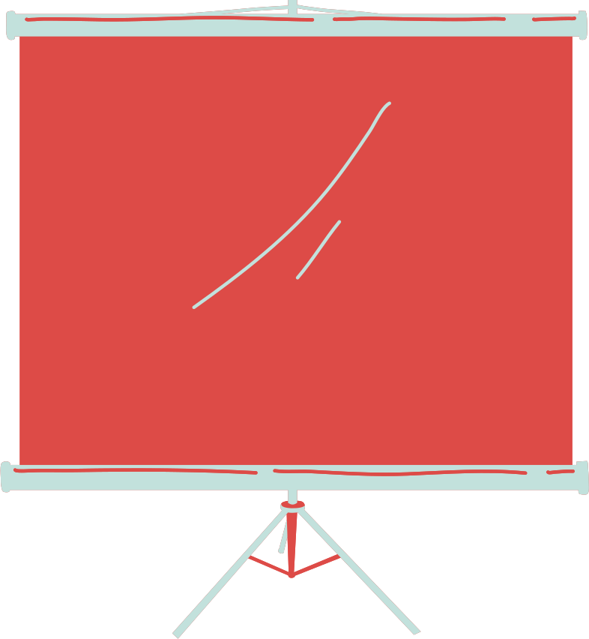
The End
Thank you for listening

